Slide 1
TCP Programming
RES, Lecture 2
Olivier Liechti

Slide 2
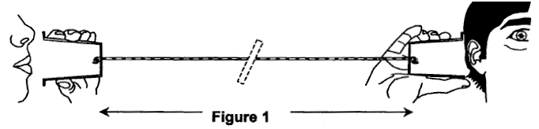
Client-Server Programming

Slide 3






HTTP
SMTP
Proprietary Protocol

Slide 4
What is an Application-Level Protocol?
A set of rules that specify how the application components (e.g. clients and servers) communicate with each other. Typically, a protocol defines at least:
Which transport-layer protocol is used to exchange application-level messages. (e.g. TCP for HTTP)
Which port number(s) to use (e.g. 80 for HTTP)
What kind of messages are exchanged by the application components and the structure of these messages.
The actions that need to be taken when these messages are received and the effect that is expected.
Whether the protocol is stateful or stateless. In other words, whether the protocol requires the server to manage a session for every connected client.

Slide 5
Network Programming
Given a application-level protocol,
how can we implement a client and server in a particular programming language?
What abstractions, APIs, libraries are available to help us do that?
We know about TCP, UDP and IP. But how can we benefit from these protocols in our code?

Slide 6

The TCP Protocol

Slide 7
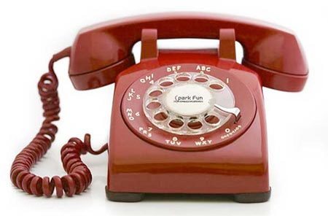


TCP
UDP

Slide 8
Transport Protocols
Both TCP and UDP are transport protocols.
This means that they make it possible for two programs (i.e. applications, processes) possibly running on different machines to exchange data.
The two protocols also make it possible for several programs to share the same network interface. They use the notion of port for this purpose.
TCP and UDP define the structure of messages. With TCP, messages are called segments. With UDP, messages are used datagrams.
The structure of TCP segments (number and size of headers) is more complex than the structure of UDP datagrams.
Both TCP segments and UDP datagrams can be encapsulated in IP packets. In that case, we say that the payload of the IP packet is a TCP segment, respectively a UDP datagram.

Slide 9
Transport Protocols
TCP provides a connection-oriented service. The client and the server first have to establish a connection. They can then exchange data through a bi-directional stream of bytes.
TCP provides a reliable data transfer service. It makes sure that all bytes sent by one program are received by the other. It also preserves the ordering of the exchanged bytes.
UDP provides a connectionless service. The client can send information to the server at any time, even if there is no server listening. In that case, the information will simply be lost.
UDP does not guarantee the delivery of datagrams. It is possible that a datagram sent by one client will never reach its destination. The ordering is not guaranteed either.
TCP supports unicast communication. UDP supports unicast, broadcast and multicast communication. This is useful for service discovery.

Slide 10
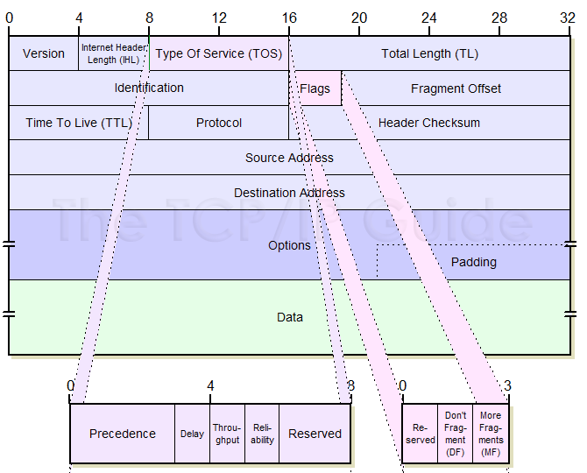
If “Data” is a TCP segment, this field has the decimal value “6”. If it is a UDP datagram, this field has the decimal value “17”.
This can contain a TCP segment, a UDP datagram, or something else.
http://www.tcpipguide.com/free/t_IPDatagramGeneralFormat.htm

Slide 11
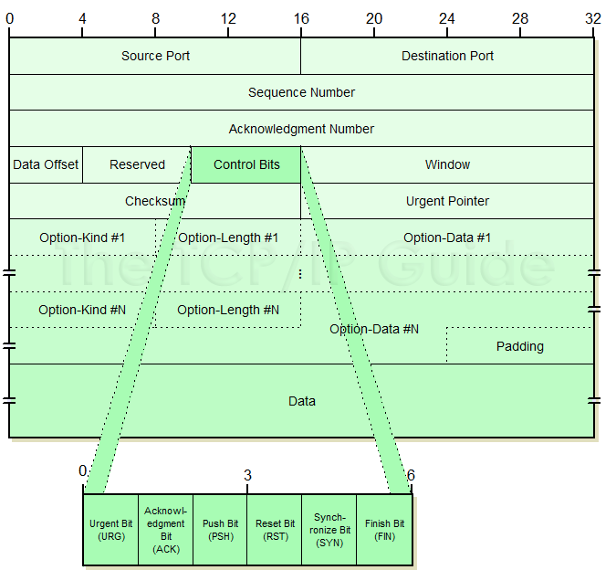
The bytes that you write in your java program will be here...
http://www.tcpipguide.com/free/t_TCPMessageSegmentFormat-3.htm

Slide 12

Example: telnet www.heig-vd.ch 80

Slide 13
Example (server): nc -kl 2019
Example (client): nc localhost 2019

Slide 14

The Socket API

Slide 15
Network Programming
Given a application-level protocol,
how can we implement a client and server in a particular programming language?
What abstractions, APIs, libraries are available to help us do that?
We know about TCP, UDP and IP. But how can we benefit from these protocols in our code?

Slide 16
The Socket API
The Socket API is a standard interface, which defines data structures and functions for writing client-server applications.
It has originally been developed in the context of the Unix operating system and specified as a C API.
It is now available across nearly all operating systems and programming environments.
<sys/socket.h>

Slide 17
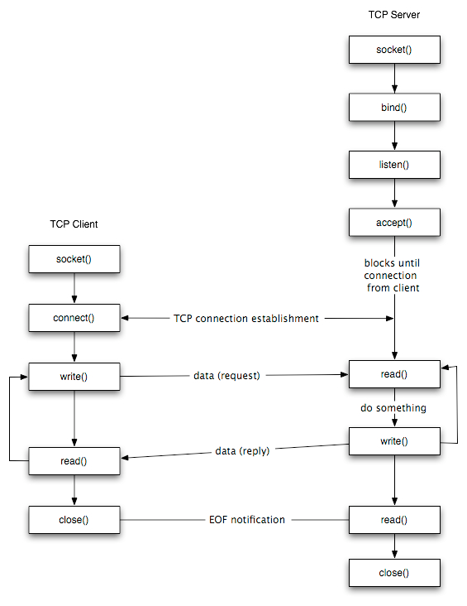
int accept(int socket, struct sockaddr *address,
socklen_t *address_len);
int bind(int socket, const struct sockaddr *address,
socklen_t address_len);
int connect(int socket, const struct sockaddr *address,
socklen_t address_len);
int getpeername(int socket, struct sockaddr *address,
socklen_t *address_len);
int getsockname(int socket, struct sockaddr *address,
socklen_t *address_len);
int getsockopt(int socket, int level, int option_name,
void *option_value, socklen_t *option_len);
int listen(int socket, int backlog);
ssize_t recv(int socket, void *buffer, size_t length, int flags);
ssize_t recvfrom(int socket, void *buffer, size_t length,
int flags, struct sockaddr *address, socklen_t *address_len);
ssize_t recvmsg(int socket, struct msghdr *message, int flags);
ssize_t send(int socket, const void *message, size_t length, int flags);
ssize_t sendmsg(int socket, const struct msghdr *message, int flags);
ssize_t sendto(int socket, const void *message, size_t length, int flags,
const struct sockaddr *dest_addr, socklen_t dest_len);
int setsockopt(int socket, int level, int option_name,
const void *option_value, socklen_t option_len);
int shutdown(int socket, int how);
int socket(int domain, int type, int protocol);
int socketpair(int domain, int type, int protocol,
int socket_vector[2]);
http://www.cs.dartmouth.edu/~campbell/cs50/socketprogramming.html

Slide 18
Using the Socket API for a TCP Server
1. Create a "receptionist" socket
2. Bind the socket to an IP address / port
3. Loop
3.1. Accept an incoming connection (block until a client arrives)
3.2. Receive a new socket when a client has arrived
3.3. Read and write bytes through this socket, communicating
with the client
3.4. Close the client socket (and go back to listening)
4. Close the "receptionist" socket

Slide 19
Using the Socket API for a TCP Client
1. Create a socket
2. Make a connection request on an IP address / port
3. Read and write bytes through this socket, communicating with the
client
4. Close the client socket

Slide 20
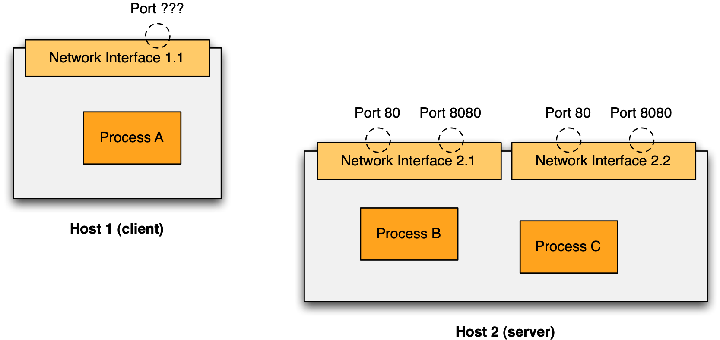
Using the Socket API

Slide 21

Using the Socket API in Java
// Listen on port 8080
ServerSocket serverSocket = new ServerSocket(8080);
// Wait (block) until a client makes a connection request...
Socket commSocket = serverSocket.accept();

Slide 22
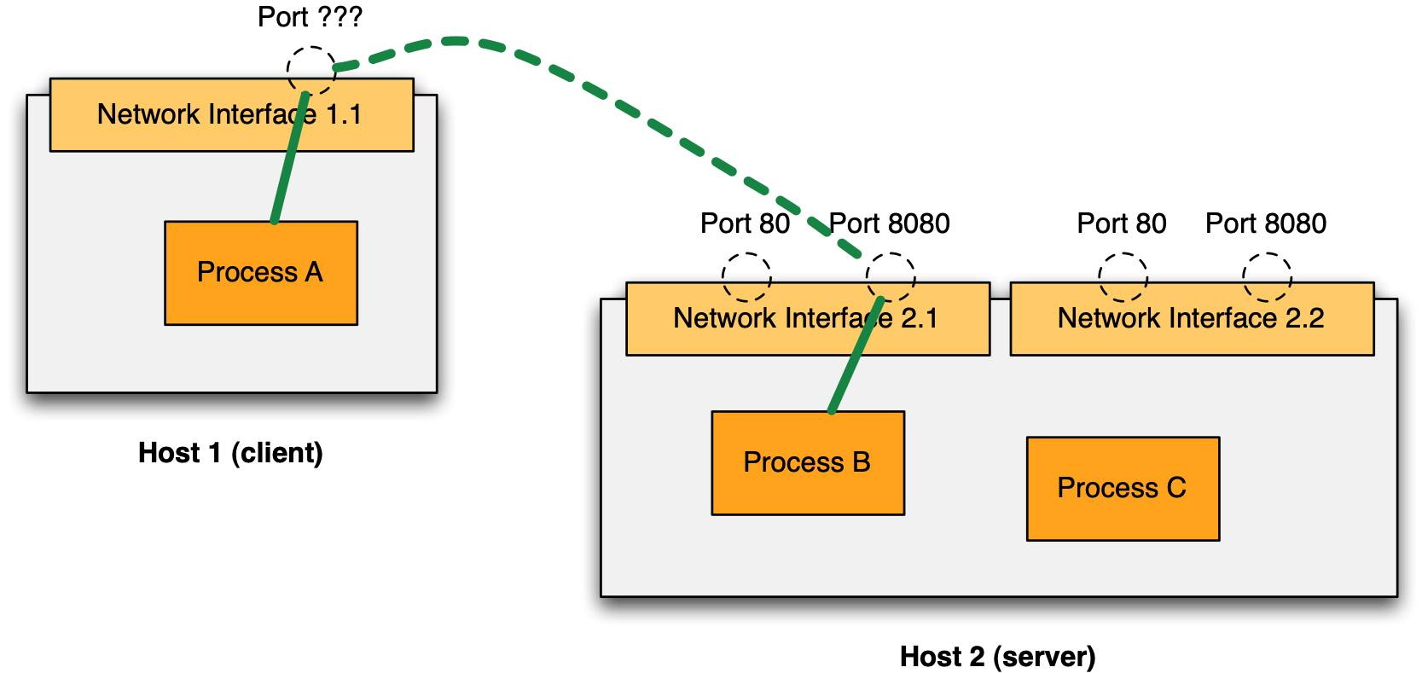
Using the Socket API in Java
// Makes a connection request on port 8080
Socket serverSocket = new Socket(“host2”, 8080);

Slide 23
Using the Socket API in Java
// Makes a connection request on port 8080
Socket socket = new Socket(“host2”, 8080);
InputStream fromServer = socket.getInputStream();
OutputStream toServer = socket.getOutputStream();
// Listen on port 8080
ServerSocket serverSocket = new ServerSocket(8080);
// Wait until a client makes a connection request...
Socket commSocket = serverSocket.accept();
InputStream fromClient = commSocket.getInputStream();
OutputStream toClient = commSocket.getOutputStream();

Slide 24
Example: 05-DumbHttpClient

Slide 25
Code walkthrough
establish a connection with server
public void sendWrongHttpRequest() {
Socket clientSocket = null;
OutputStream os = null;
InputStream is = null;
try {
clientSocket = new Socket(“www.lematin.ch”, 80);
os = clientSocket.getOutputStream();
is = clientSocket.getInputStream();
String malformedHttpRequest = "Hello, sorry, but I don't speak HTTP...\r\n\r\n";
os.write(malformedHttpRequest.getBytes());
ByteArrayOutputStream responseBuffer = new ByteArrayOutputStream();
byte[] buffer = new byte[BUFFER_SIZE];
int newBytes;
while ((newBytes = is.read(buffer)) != -1) {
responseBuffer.write(buffer, 0, newBytes);
}
LOG.log(Level.INFO, "Response sent by the server: ");
LOG.log(Level.INFO, responseBuffer.toString());
} catch (IOException ex) {
LOG.log(Level.SEVERE, null, ex);
} finally {
...
}
}
get streams to send and receive bytes
read bytes sent by the server until the connection is closed

Slide 26
Example: 04-StreamingTimeServer

Slide 27
Code walkthrough
bind on TCP port
ServerSocket serverSocket = null;
Socket clientSocket = null;
BufferedReader reader = null;
PrintWriter writer = null;
try {
serverSocket = new ServerSocket(listenPort);
logServerSocketAddress(serverSocket);
clientSocket = serverSocket.accept();
logSocketAddress(clientSocket);
reader = new BufferedReader(new InputStreamReader(clientSocket.getInputStream()));
writer = new PrintWriter(clientSocket.getOutputStream());
for (int i = 0; i < numberOfIterations; i++) {
writer.println(String.format("{'time' : '%s'}", new Date()));
writer.flush();
LOG.log(Level.INFO, "Sent data to client, doing a pause...");
Thread.sleep(pauseDuration);
}
} catch (IOException | InterruptedException ex) {
LOG.log(Level.SEVERE, ex.getMessage());
} finally {
reader.close();
writer.close();
clientSocket.close();
serverSocket.close();
}
block until a client makes a connection request
we want to exchange characters with the clients (we should specify the encoding!)
we make sure to flush the buffer, so that characters are actually sent!

Slide 28
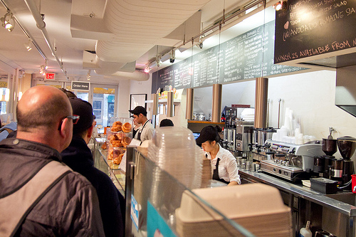
Handling Concurrency

Slide 29
Concurrency in Network Programming
You don’t want your server to talk to only one client at the time, do you?
Even for stateless protocols...

Slide 30

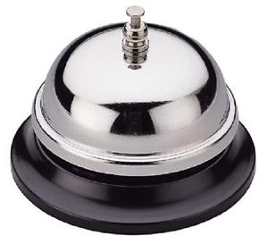
blocking IO (synchronous)
n employee = n threads
employees are expensive
limited space for employees in the truck
few employees => long queue
non-blocking IO (asynchronous)
there is only 1 employee (1 thread)
customers are called back when the request is fulfilled
no queue

Slide 31
Concurrent Programming
On top of the operating system, it is possible launch the Java Virtual Machine (JVM) several times (by invoking the java command). In this scenario, there is one process (program) for every JVM instance.
If you don’t do anything special, there is a single execution thread within each JVM. This means that all instructions in your code are executed sequentially.
Very often, you write software where you want to perform several tasks at the same time (concurrently). For instance:
Manage a UI while fetching data from the network,
Talking to one HTTP client while talking to another HTTP client,
Have a worker do complex calculations on a subset of the data, while having another worker do the same calculations on another subset.
You can use threads (also called lightweight processes) for this purpose.

Slide 32
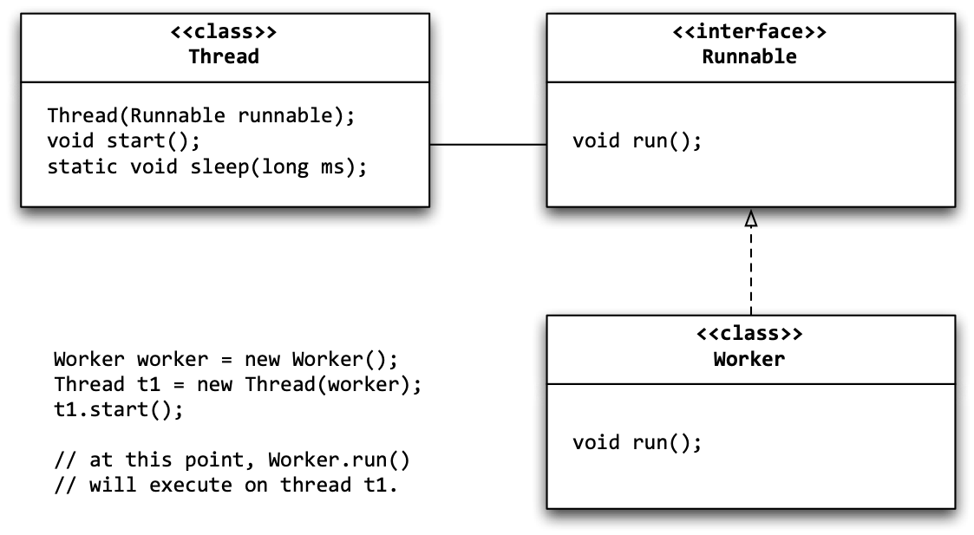
Concurrent Programming in Java
In Java, there are two main types
The Thread class, which could be extended to implement the behaviour you want to run in parallel.
The Runnable interface, which is implemented for the same purpose and is passed as an argument to the Thread constructor.

Slide 33
Concurrent Programming in Java
There are other classes related to threads, in the java.util.concurrent package. An important one is the ExecutorService, which makes it possible to use thread pools.
A thread pool gives you a way to limit the number of threads spawned (by your server), so that you will not consume all resources. Others are queued.
package de.vogella.concurrency.threadpools;
import java.util.concurrent.ExecutorService;
import java.util.concurrent.Executors;
public class Main {
private static final int NTHREDS = 10;
public static void main(String[] args) {
ExecutorService executor = Executors.newFixedThreadPool(NTHREDS);
for (int i = 0; i < 500; i++) {
Runnable worker = new MyRunnable(10000000L + i);
executor.execute(worker);
}
// This will make the executor accept no new threads
// and finish all existing threads in the queue
executor.shutdown();
// Wait until all threads are finish
executor.awaitTermination();
System.out.println("Finished all threads");
}
}
http://www.vogella.com/tutorials/JavaConcurrency/article.html

Slide 34
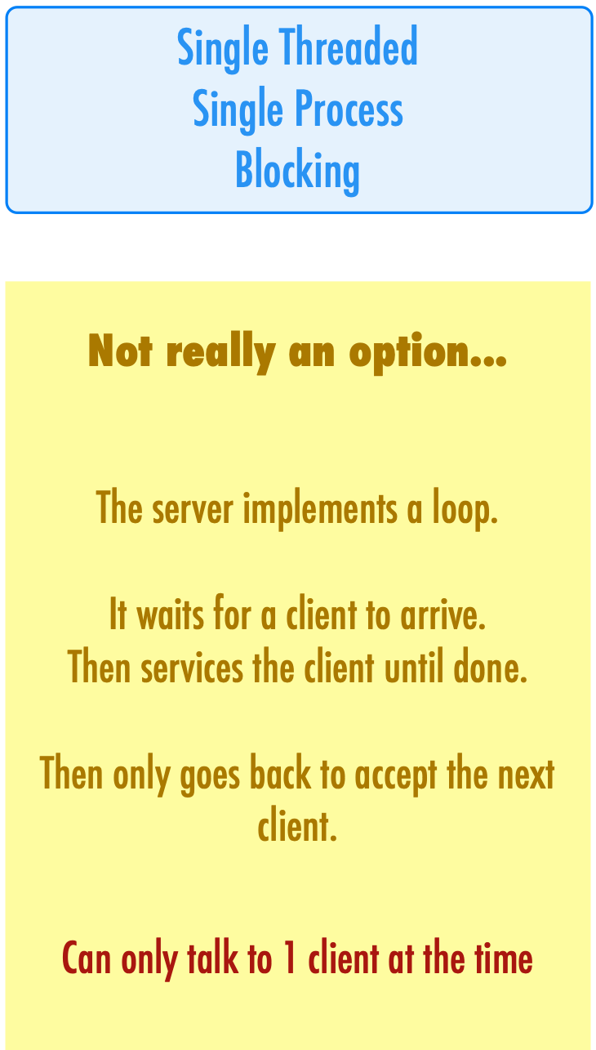
It is only when we reach this line that a new client can connect
serverSocket = new ServerSocket(port);
while (true) {
clientSocket = serverSocket.accept();
in = new BufferedReader(new InputStreamReader(clientSocket.getInputStream()));
out = new PrintWriter(clientSocket.getOutputStream());
String line;
boolean shouldRun = true;
LOG.info("Reading until client sends BYE");
while ( (shouldRun) && (line = in.readLine()) != null ) {
if (line.equalsIgnoreCase("bye")) {
shouldRun = false;
}
out.println("> " + line.toUpperCase());
out.flush();
}
clientSocket.close();
in.close();
out.close();
}
It takes a long time to serve each client

Slide 35
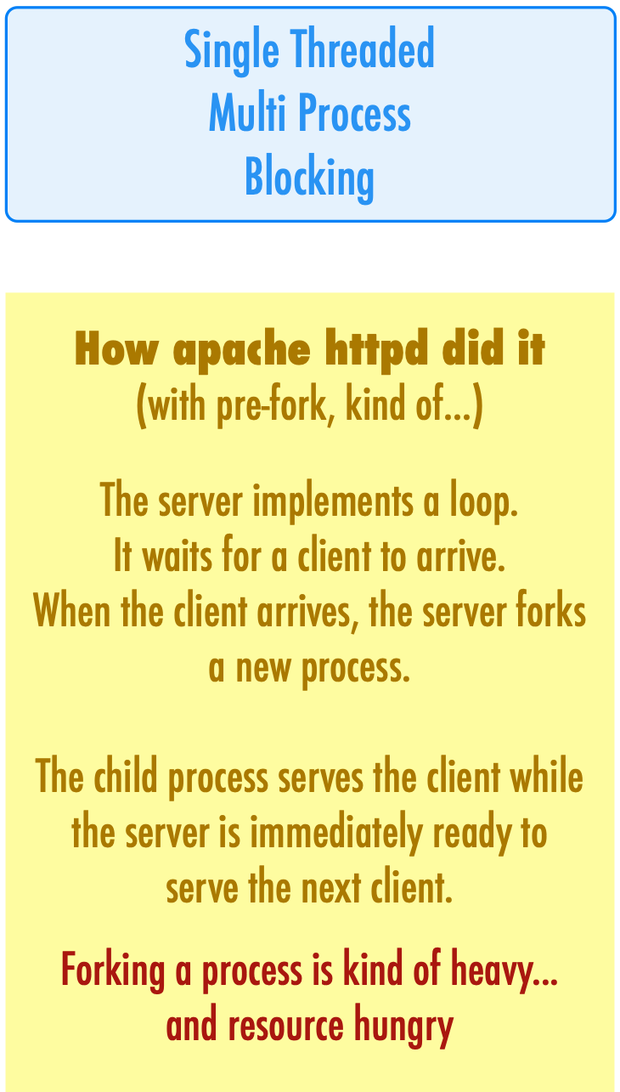
While the child process serves the client...
... the parent can immediately welcome the next client.
while(1) { // main accept() loop
sin_size = sizeof their_addr;
new_fd = accept(sockfd, (struct sockaddr *)&their_addr, &sin_size);
if (new_fd == -1) {
perror("accept");
continue;
}
inet_ntop(their_addr.ss_family,
get_in_addr((struct sockaddr *)&their_addr),
s, sizeof s);
printf("server: got connection from %s\n", s);
if (!fork()) { // this is the child process
close(sockfd); // child doesn't need the listener
if (send(new_fd, "Hello, world!", 13, 0) == -1)
perror("send");
close(new_fd);
exit(0);
}
close(new_fd); // parent doesn't need this
}
http://www.beej.us/guide/bgnet/output/html/multipage/clientserver.html#simpleserver

Slide 36
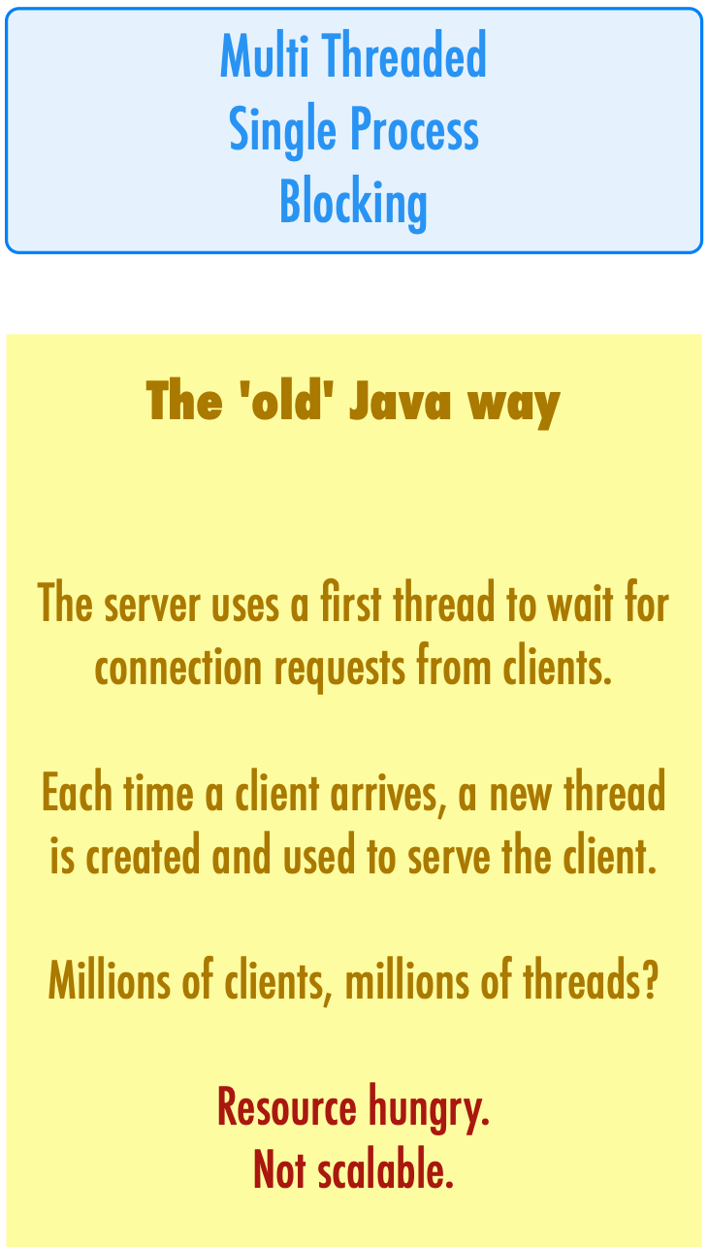
The ReceptionistWorker implements a run() method that will execute on its own thread.
private class ReceptionistWorker implements Runnable {
@Override
public void run() {
ServerSocket serverSocket;
try {
serverSocket = new ServerSocket(port);
} catch (IOException ex) {
LOG.log(Level.SEVERE, null, ex);
return;
}
while (true) {
LOG.log(Level.INFO, "Waiting for a new client”);
try {
Socket clientSocket = serverSocket.accept();
LOG.info("A new client has arrived...");
new Thread(new ServantWorker(clientSocket)).start();
} catch (IOException ex) {
LOG.log(Level.SEVERE, ex.getMessage(), ex);
}
}
}
}
As soon as a client is connected, a new thread is created.
The code that manages the interaction with the client executes on this thread.
2 types of workers, n+1 threads

Slide 37
Example: 07-TcpServers

Slide 38
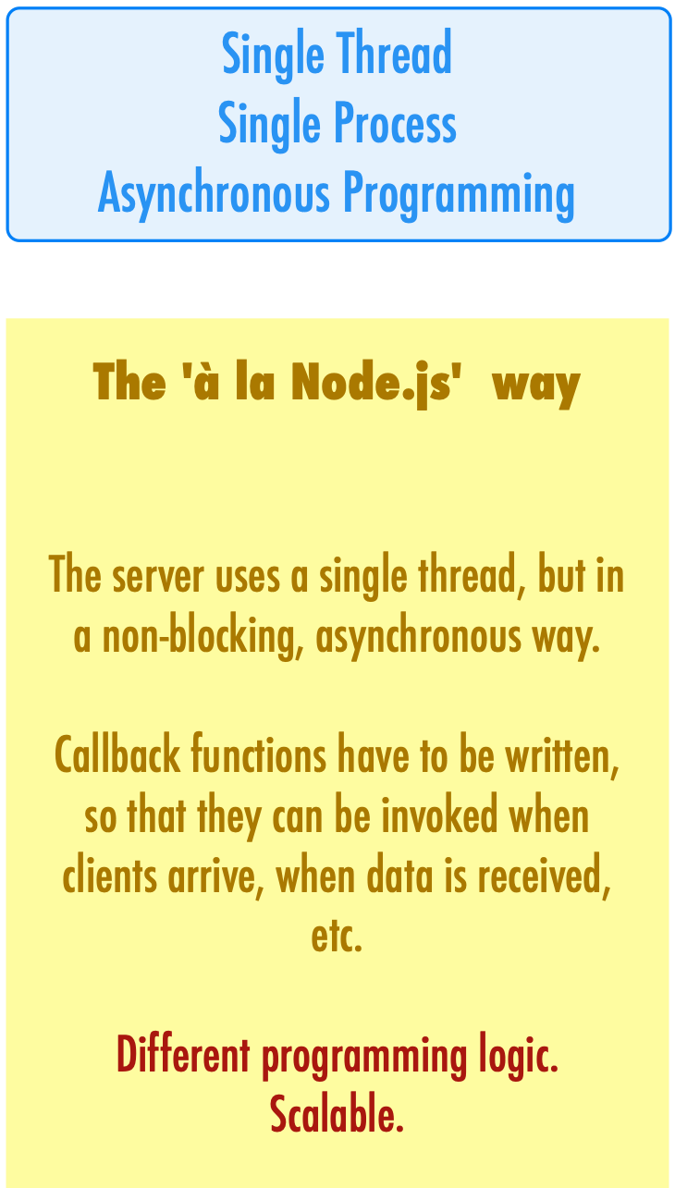
We are registering callback functions on the various types of events that can be notified by the server...
// let's create a TCP server
const server = net.createServer();
// it reacts to events: 'listening', 'connection', 'close', etc.
// register callback functions, to be invoked when the events
// occur (everything happens on the same thread)
server.on('listening', callbackFunctionToCallWhenSocketIsBound);
server.on('connection', callbackFunctionToCallWhenNewClientHasArrived);
//Start listening on port 9907
server.listen(9907);
// This callback is called when the socket is bound and is in
// listening mode. We don't need to do anything special.
function callbackFunctionToCallWhenSocketIsBound() {
console.log("The socket is bound and listening");
console.log("Socket value: %j", server.address());
}
// This callback is called after a client has connected.
function callbackFunctionToCallWhenNewClientHasArrived(socket) {
...
}
... and we code these functions, implementing the behavior that is expected when the events occur.

Slide 39
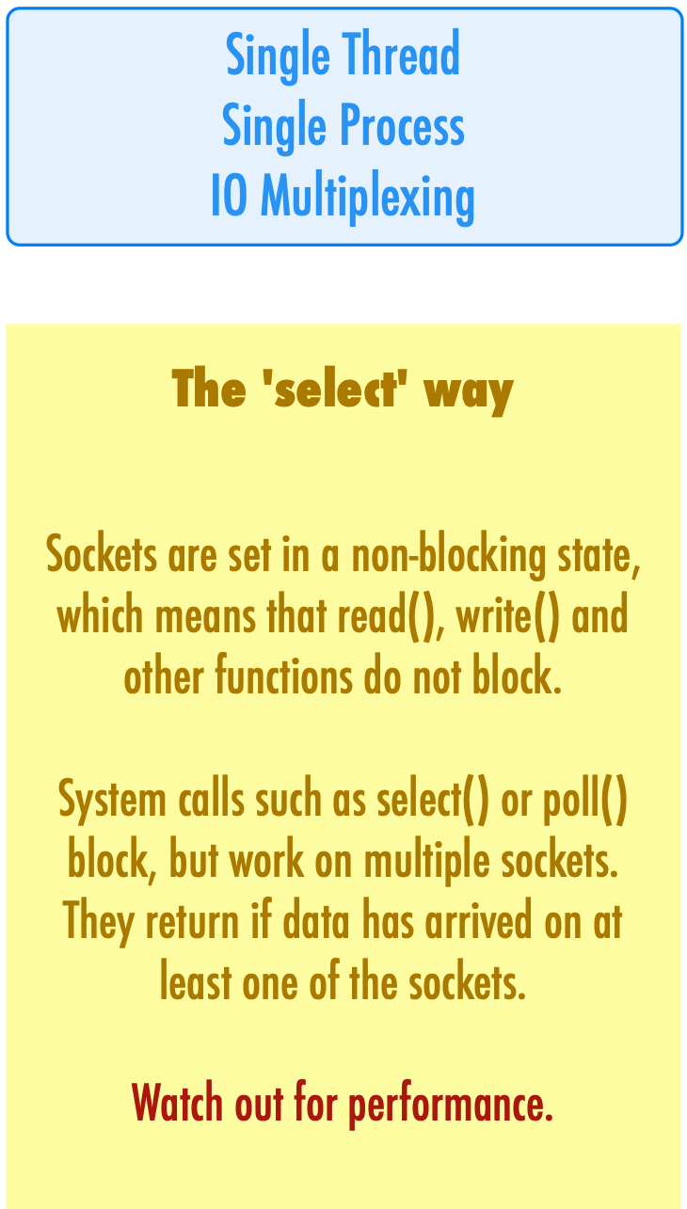
Select is a blocking operation (with a possible timeout). It blocks until something has happened on one of the provided sets of file descriptors.
#include <stdio.h>
#include <sys/time.h>
#include <sys/types.h>
#include <unistd.h>
int main(void) {
fd_set rfds;
struct timeval tv;
int retval;
/* Watch stdin (fd 0) to see when it has input. */
FD_ZERO(&rfds);
FD_SET(0, &rfds);
/* Wait up to five seconds. */
tv.tv_sec = 5;
tv.tv_usec = 0;
retval = select(1, &rfds, NULL, NULL, &tv);
/* Don't rely on the value of tv now! */
if (retval == -1)
perror("select()");
else if (retval)
printf("Data is available now.\n");
/* FD_ISSET(0, &rfds) will be true. */
else
printf("No data within five seconds.\n");
return 0;
}
Here, we know that something has happened on one of the sockets. We can iterate over the set of file descriptors and get the data.

Slide 40
Example: 06-PresenceApplication

